Slide 1
Python: Lesson #3
Functions… Again
By: Marc Geffroy

Slide 2
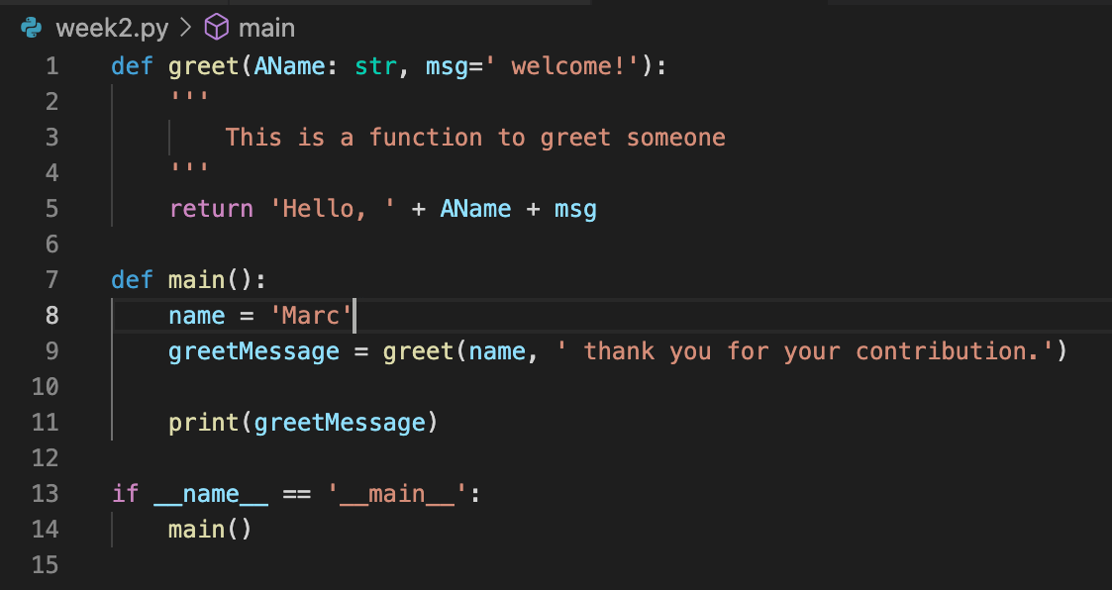
What was covered last lesson?
What is a function.
Why we use functions.
The syntax of functions
Defining a function.
Calling a function.
Variable scope and lifetime.
Parameters/arguments (typing).
Return values.
Example code:
Defining a function.
Refactoring large code section into functions.

Slide 3
Maintainability Through Functions
Functions increase maintainability and reusability.
We cannot have an entire application in a single file.
MODULES!!!!!!
Modules are python files consisting of python code.
Modules can consist of classes, functions and/or variables.
There is no hard set rules in Python around modules ie no IDE errors, warnings or hints.
It’s up to programmers to mind their manners.

Slide 4
Module Syntax #1
“Greetings.py”
def greetGuest(): print(‘Hello, how do you do?’)
def greetFriend(AName): print(‘Hey ’ + AName + ‘, how you buddy?’)
def greetMother(): print(‘Hello Mother dearest’)
def greetEnemy(): print(‘Hmmmph…’)
Setting up a module:
Ensure a relevant name for the file ie ‘Greetings.py’.
Ensure that the path to the module can be found.
Define some python code inside the file.
Hint: Keep related code in a module. Create additional modules as needed

Slide 5
Module Syntax #2
Using a module:
To use a module, you have to import the module file using the import keyword.
You can also use the ‘from…import…’ to only import specific attributes from the module.
To use/call a module’s attribute you use dot notation (Object Oriented calling language) in the following syntax:
module_name.module_attribute
import Greetings
myFriend= ‘Trevor’ Greetings.greetFriend(myFriend)
>>> Hey Trevor, how you buddy?
From Greetings import greetEnemy
greetEnemy()
>>> Hmmmph…

Slide 6
ASCII

Slide 7
What is ASCII? American Standard Code for Information Interchange
ASCII is a character encoding used between computers on the internet.
ASCII was developed in the 60s.
ASCII uses 7 bits to encode 128 characters
0-9
a-z
A-Z
Special characters.

Slide 8
